Slide 1
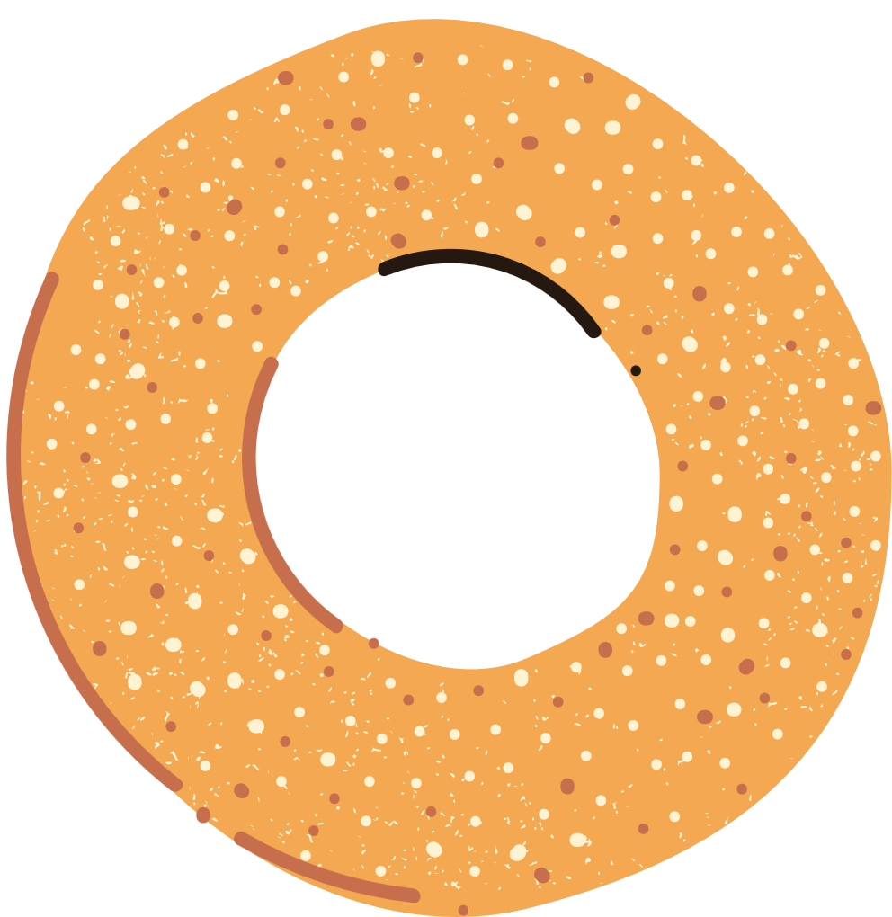
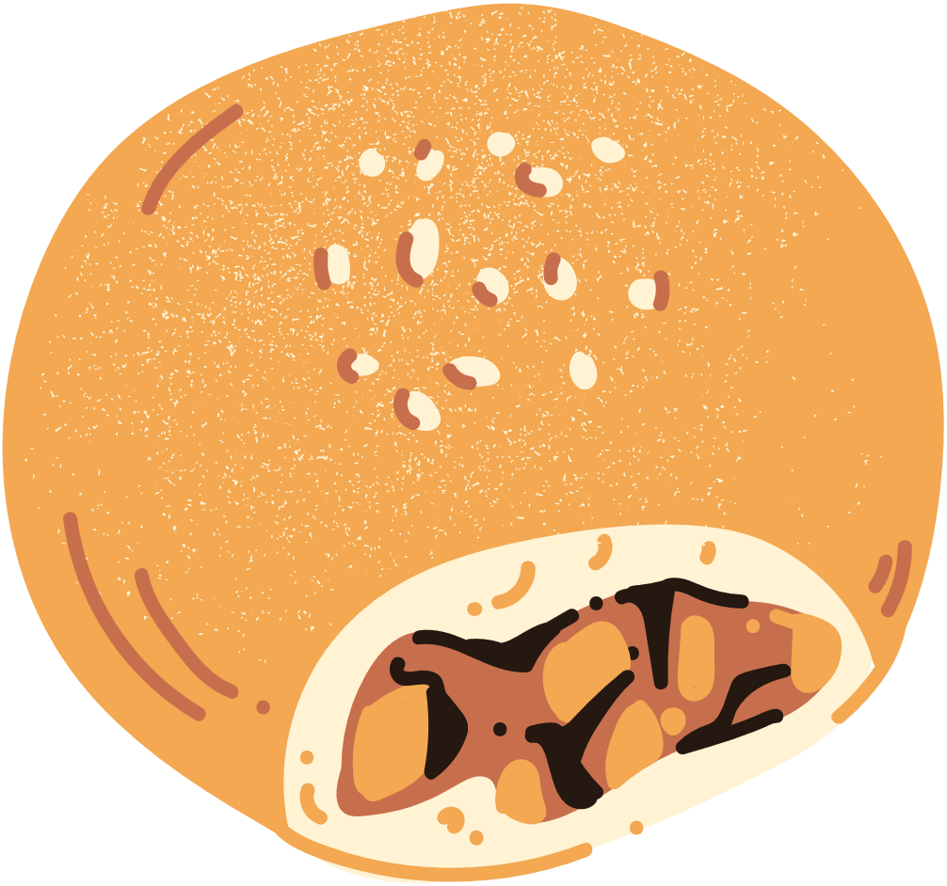






YUM
CART
Dessert Shop by
JAVARIA NASIR

Slide 2

Project
Introduction
YumCart is a simple desktop application designed to manage a dessert shop. It allows customers to browse desserts, add them to a cart, and place orders, while admins can manage products easily.

Slide 3



Tools
& Tech
Programming Languages
Tools
Database
VS Code
Python unittest framework
Python 3.12
Tkinter (GUI Library)
SQLite3 (Local file-based database)

Slide 4
Project
Objective
Make a simple and easy-to-use interface for customers.
Allow customers to view desserts and add them to a cart
Enable customers to place orders easily
Store products and orders securely using SQLite database
Provide an admin panel to manage products and categories
Basic GUI programming with Python Tkinter and database.

Slide 5



Features
Offered
02
03
04
01
Product Display
Fetches desserts from database
Shows name, price, category
Auto-updates when new items are added
Shopping Cart System
Add item to cart
Remove item from cart
Calculating total
Refresh cart window after actions
User Login System
Secure login screen
Basic authentication
Customer Features
Clean UI
view desserts, add to cart, checkout

Slide 6
Features
Offered
05
06
Admin Panel
Add new dessert
Edit existing dessert
Delete dessert
View all desserts
View categories
Category Management
Shows all available categories
Category dropdown

Slide 7

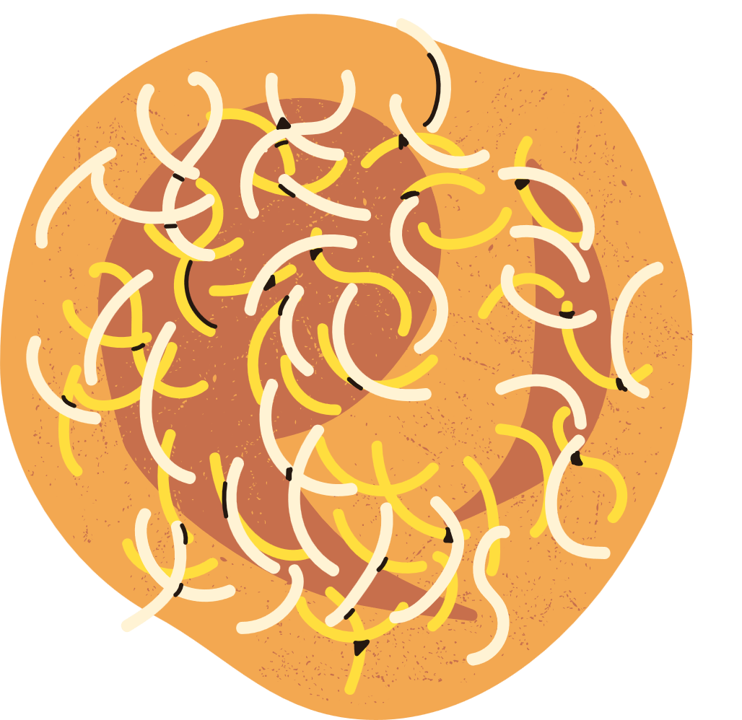

Database Used:
SQLite – lightweight, file-based database stored inside the project directory.
Tables Created :
Product Table
Order Table
Database
Design

Slide 8

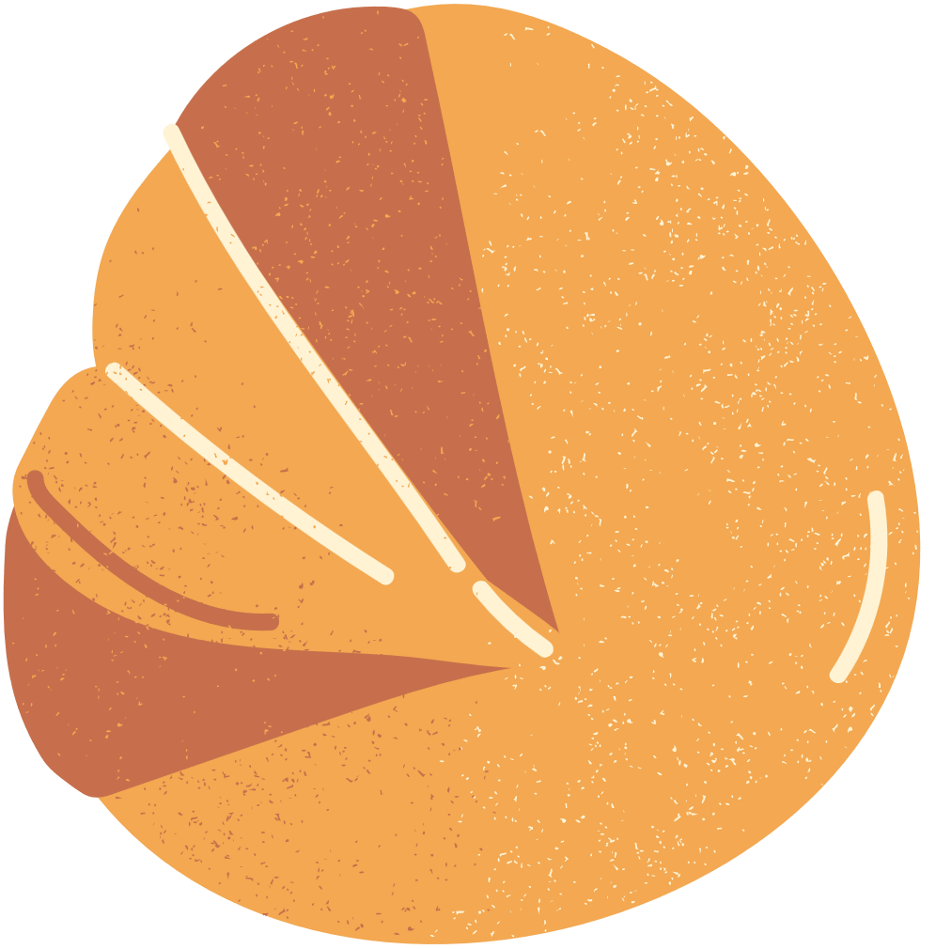

Used: Python unittest
Tested Core Functions:
Product validation
Category extraction
Cart management
Checkout calculations
Delete & add product logic
Ensures:
Accuracy
Stability
Error-free logic
Unit
Testing

Slide 9
Refactoring
Before Refactoring
GUI + database + logic all mixed in same file
Hard to test
Hard to maintain
Messy Code
After Refactoring
gui.py → separate gui.py files of interfaces
clear folder structure
models/ → product class separated
database/database.py → unified DB connection
testlogic.py → fully independent test file
Database queries separated

Slide 10


How to
A Behind-the-Scenes Look
Run
Install Python
Install requirements
(Tkinter built-in, sqlite3 built-in)
Run app.py
Database initializes automatically

Slide 11




See You
yumcartofficial 🅾ⓕ

